Slide 1
Ravenswood Gold
Building Queensland’s largest
gold mine
  11 March 2021

Slide 2
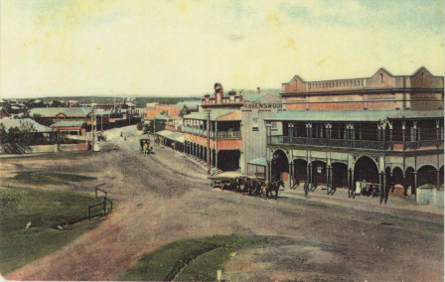
History of Ravenswood
Gold first discovered 1868
Second gold rush in ~1890 – 1910
Decline in 1910’s due to WWI labour shortage and deeper, more costly workings
Mother Lode at Mt Wright and Golden Hill (Sarsfield) worked in the 1930’s
Historical production ~1,000,000oz gold

Slide 3
Ravenswood Gold
  Who are we?
  Ravenswood Gold Pty Ltd purchased the assets of Carpentaria Gold on 1 April 2020
  Ravenswood Gold Pty Ltd is a 50/50 Joint Venture between EMR Capital and Golden Energy and Resources (GEAR)
    EMR Capital is a private equity investment fund
    GEAR is a public company listed on the Singapore Stock Exchange, with significant investments in Indonesia and Australia
  The Ravenswood Gold Board of Directors is made up of 6 members:
    3 members representing EMR Capital
      Owen Hegarty (Chairman)
      Peter Herbert
      Brett Fletcher (CEO)
    3 members representing GEAR
      Joshua Cochrane
      Mark Zhou
      Dwi Prasetyo Suseno

Slide 4
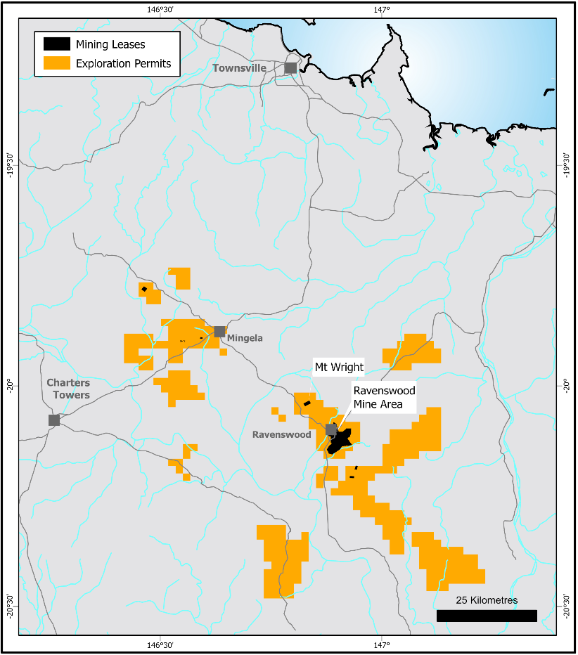
Ravenswood Gold
  What are we?
Ravenswood Gold Tenements
  Extensive tenement package across 1,144km²
  The Ravenswood Development Plan will result in a large-scale, low-cost, long-life mining and processing operation
  Current planned ore sources
    Buck Reef West pit, with potential for high grade underground operations
    Sarsfield-Nolans pit
  Extensive exploration targets provide significant potential upside
    Expand on current Mineral Resources and Ore Reserves
    Numerous near-mine targets
    Potential Business Development opportunities with other tenement holders in the region

Slide 5
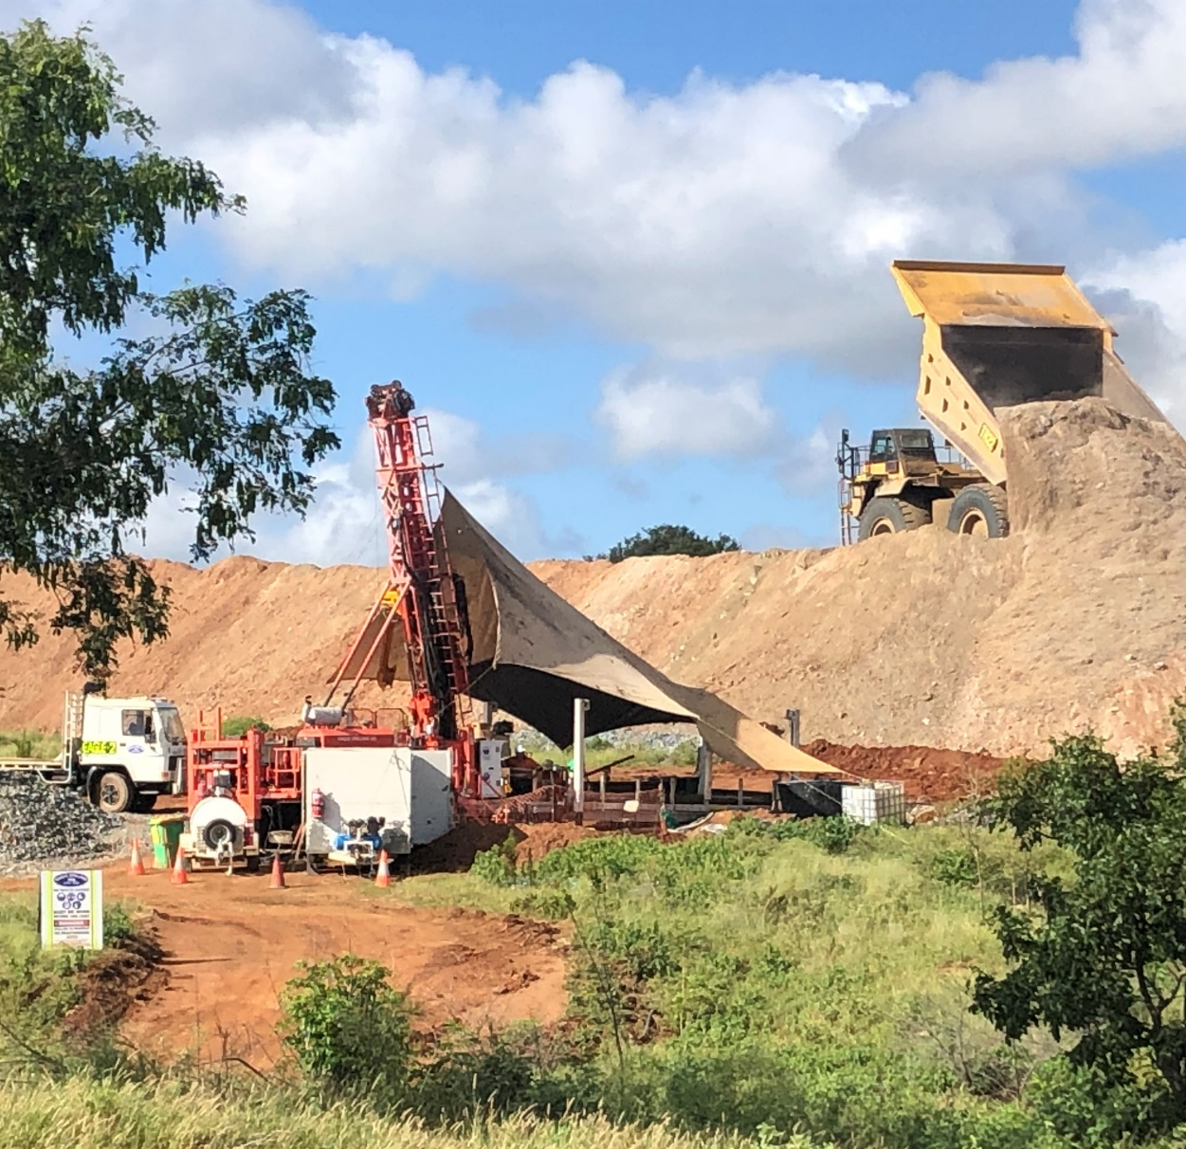
Exploration & geology
  The key to further expansion
Mineral Resource
  Total Mineral Resource of 177Mt at 0.7 g/t for 3.96Moz
  Independent experts utilised to generate Mineral Resource Estimate (and Ore Reserve Estimate)
  Independent Peer Review of the Mineral Resource completed prior to publishing
Exploration
  Growing the Mineral Resource (and potentially Ore Reserve) for the two pits in the current Life of Mine Plan
  Near mine targets to expand and/or extend production capacity
    A number of both untested and under-tested targets <10km of the Nolans Process Plant
  Targets in existing tenements further afield
  BD opportunities in the district
  Exploration team has been expanded
  Currently 2 drill rigs operating
  Potential for an additional rig to fast track Resource definition

Slide 6
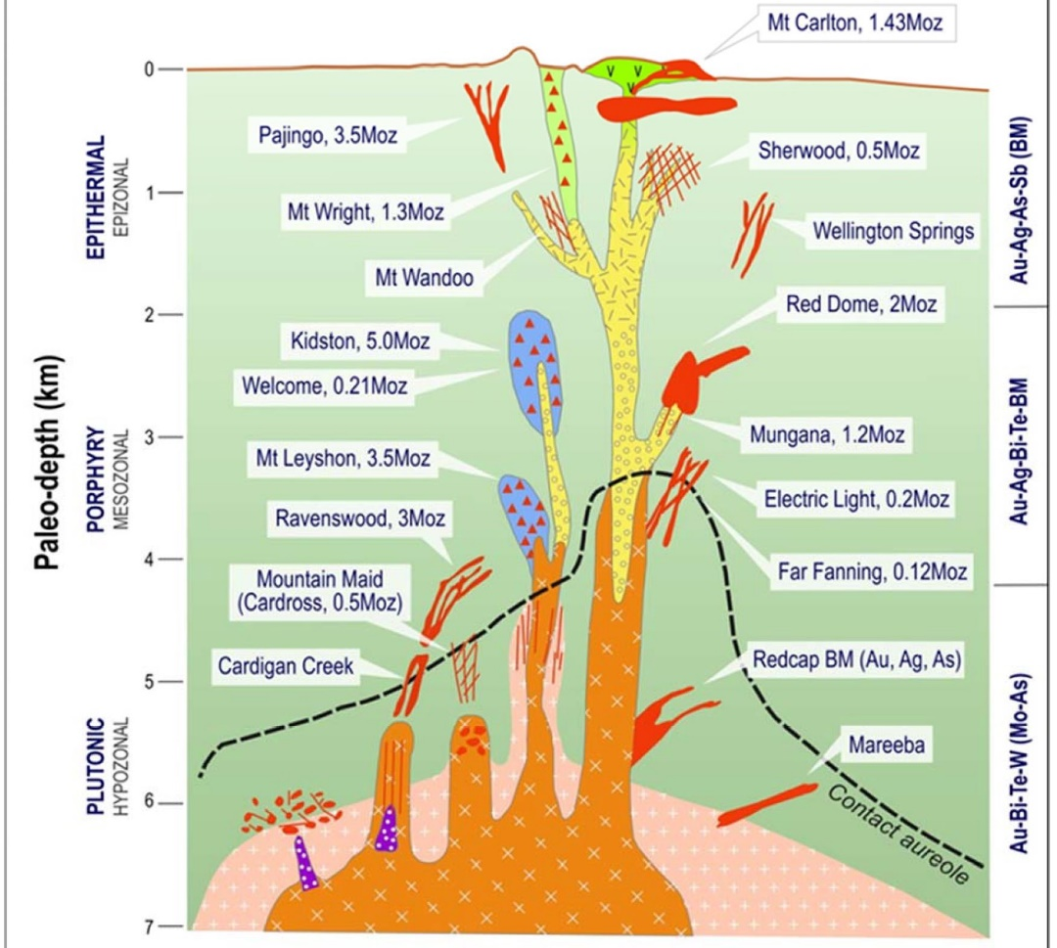
Mineralisation in nth qld
Mineralisation styles and ages in the area are diverse:
  Carboniferous-Permian Intrusion related:
    Ravenswood (veins / stockwork)
    Mt Leyshon, Mt Wright (breccia)
  Carboniferous-Permian Epithermal:
    Pajingo (low sulphidation) - Carboniferous
    Mt Carlton (high sulphidation) - Permian
  Devonian Orogenic Lode Au:
    Charters Towers, Hadleigh Castle
  Ordovician VHMS (+/- Au):
    Thalanga, Highway-Reward

Slide 7
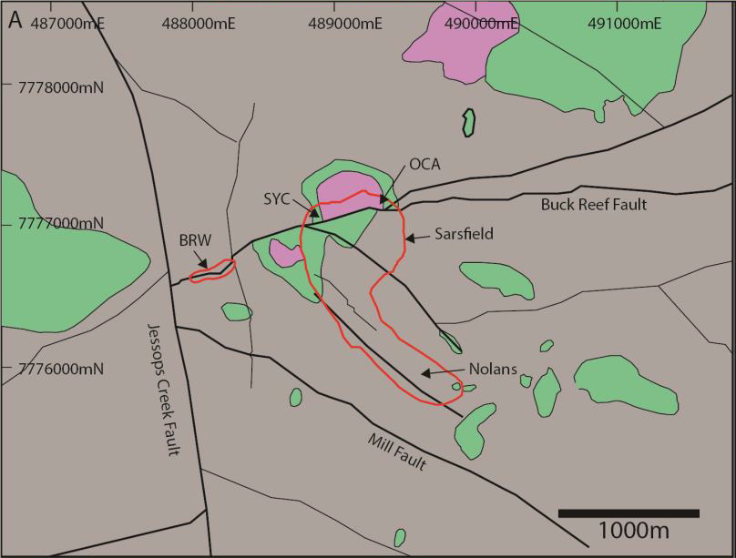
Ravenswood geology
  Structurally controlled Intrusion Related Gold Deposit.
  Host rock: Jessop Creek Tonalite (see below) with diorite & gabbro enclaves (xenoliths / intrusives).
  Pre-mineral faults partly control the distribution of mineralisation but do not define it.
  Au mineralisation hosted within faults and veins. Minor mineralisation within wall rocks.
  Post-mineralisation faults locally offset mineralisation.
Gabbro
Diorite

Slide 8
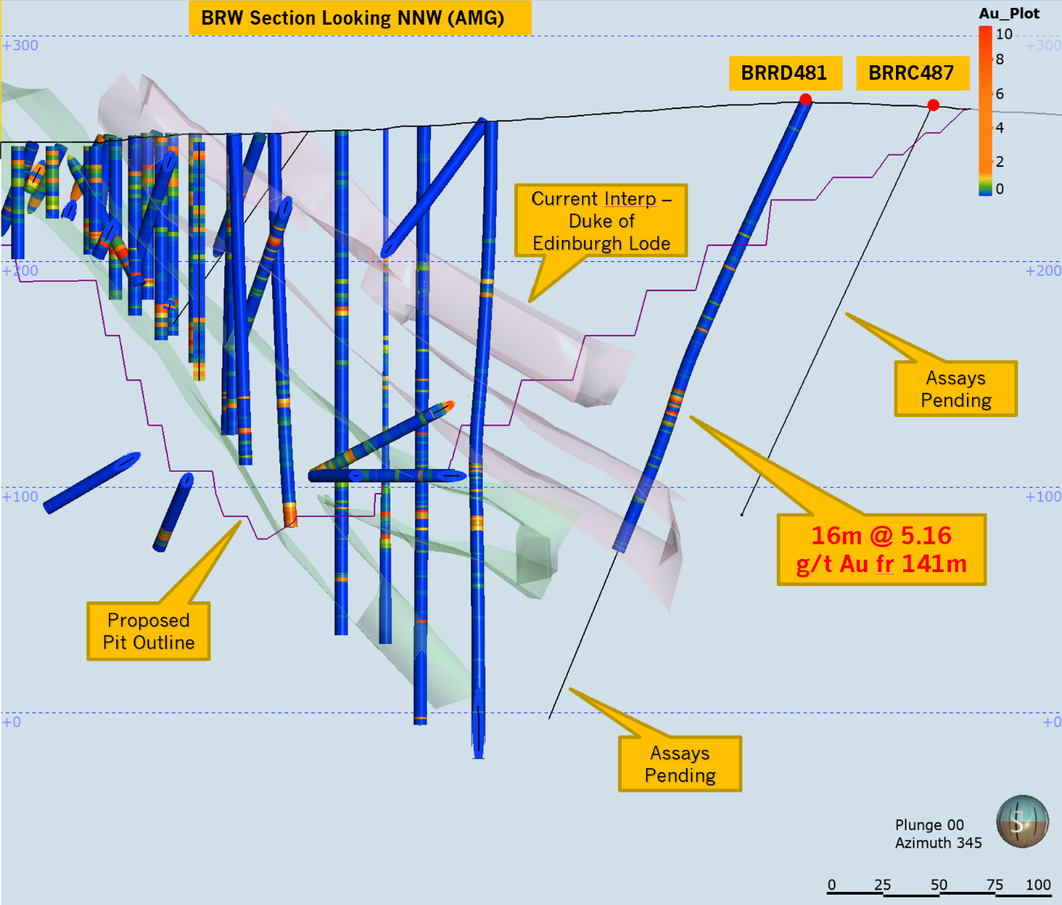
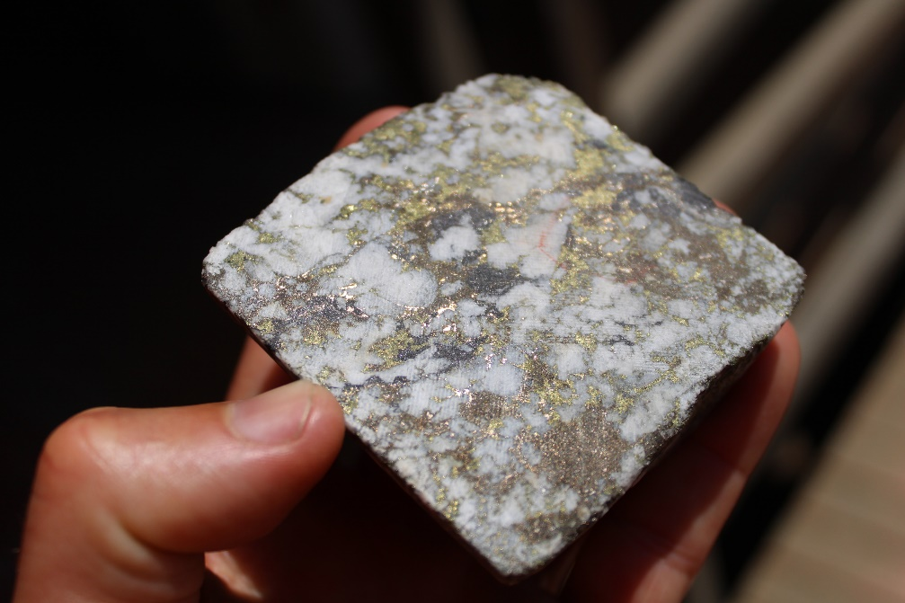
Exploration & geology
  BRW Resource – results to date
BRW Results
A number of holes have returned ore grade intercepts including:
BRRD470: 7m @ 4.01 g/t Au fr 154m
BRRD472: 11m @ 1.07 g/t Au fr 30m, 18m @ 1.02 g/t Au fr 70m & 1m @ 110 g/t Au fr 294m (below).
BRRD481: 16m @ 5.13 g/t Au fr 141m (right)
Resource upgrade being undertaken (March 2021).
Visible Gold. BRRD472: 1m @ 110 g/t Au. Sits below current pit shell

Slide 9
Ore reserve

Slide 10
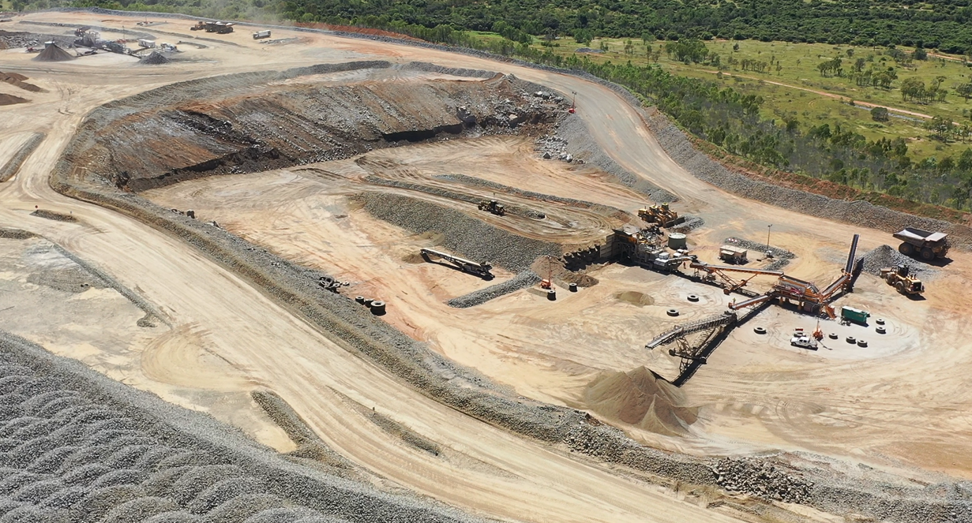
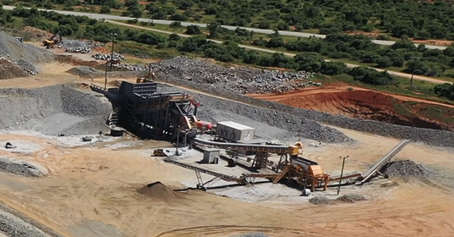
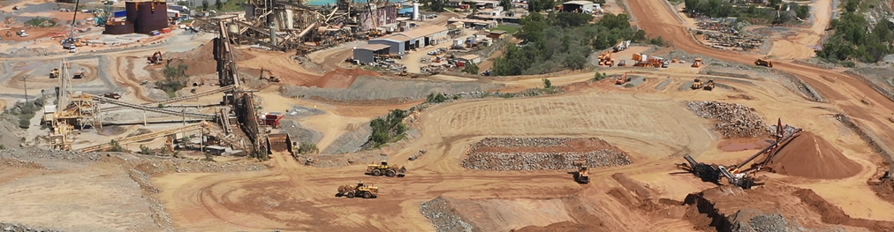
Current operations
  Majority of mill feed throughout 2020 and early 2021 is beneficiated low grade material sourced from the Sarsfield Waste Rock Dump
    Mining in Sarsfield ceased in 2009
  Multiple (5) crushing circuits on site to generate up to 5Mtpa of beneficiated product

Slide 11
People power
31 March 2020 – Carpentaria Gold
1 March 2021 – Ravenswood Gold
  156 Permanent employees transferred from CG to RG
  14% Female
  1.2% Indigenous
  289 Permanent employees (+133)
  20.9% Female (+6.9%)
  2.1% Indigenous (+0.9%)
  277 Site-based & 12 Brisbane-based
  All except 2 site-based employees reside in a 48## postcode
  90% of the site-based employees live <2hr drive from Ravenswood
    Ravenswood
    Townsville
    Charters Towers
    Burdekin (Ayr & Home Hill)

Slide 12
Ravenswood development plan
  5 Pillars of the Ravenswood Development Plan
  Mining
  $120M Mining fleet
  Buck Reef West Pit
    Potential U/G opportunities
  Sarsfield-Nolans Pit
  Drilling services contract
  Blasting services contract
  Processing
  ~$200M plant expansion to ≥7.2Mtpa in 3 stages
  3 x 5,000m³ new leach tanks
  New 3-stage crushing circuit and further 3 x 5,000m³ leach tanks
  Additional 12MW Ball mill
  TSF
  160Ha Tailings Storage Facility
    Bituminous membrane liner
    Underdrainage and decant water recovery
    Waste rock embankment
    Downstream lifts
  Dredging
  Dredge the Sarsfield pit
  Removal of ~28Mt of tailings and ~4GL of water from Sarsfield pit to new TSF
  Infrastructure
  $70M investment
  New school (completed 2020)
  Camp expansion
  Roads & intersections
  Power upgrade
  Mine Services Area
  Water Treatment Plant
  Utilities relocation

Slide 13
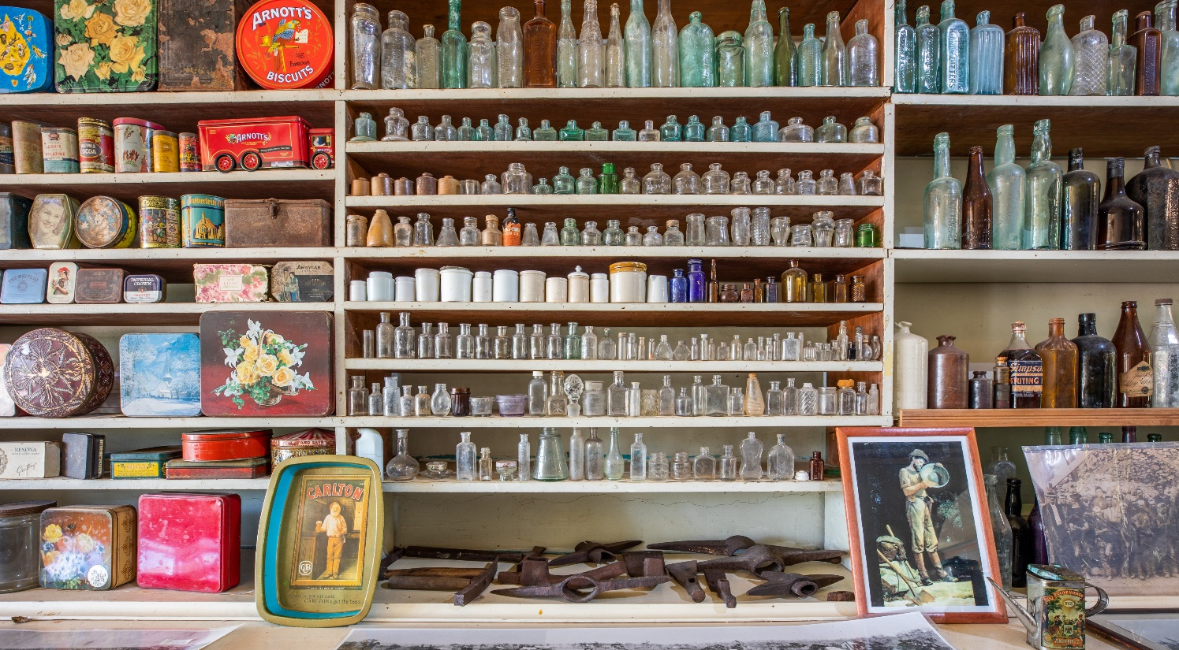
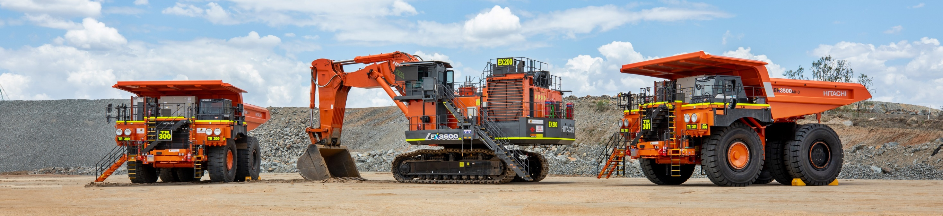
mining
  Owner-operated mining fleet (load, haul, ancillary)
  Drilling services contracted to local drilling company (Roc Drill)
  Blasting services contracted to Orica
    Significant site law work done prior to mining to ensure compliance with strict vibration limits
    Protection of both the community and the heritage buildings/structures in the town

Slide 14
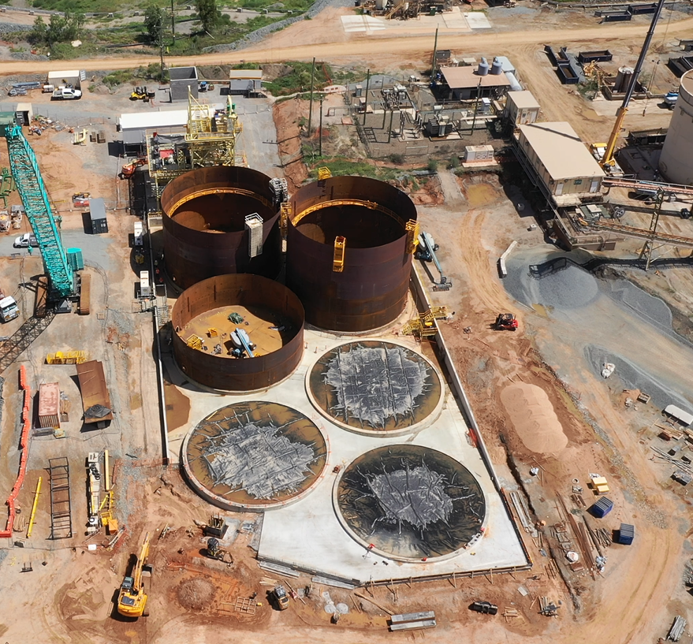
processing
  Stage 1
  3 x 5,000m3 leach tanks
    > 24hrs residence time at 5Mtpa
  Civil works underway for Stage 2 works

Slide 15
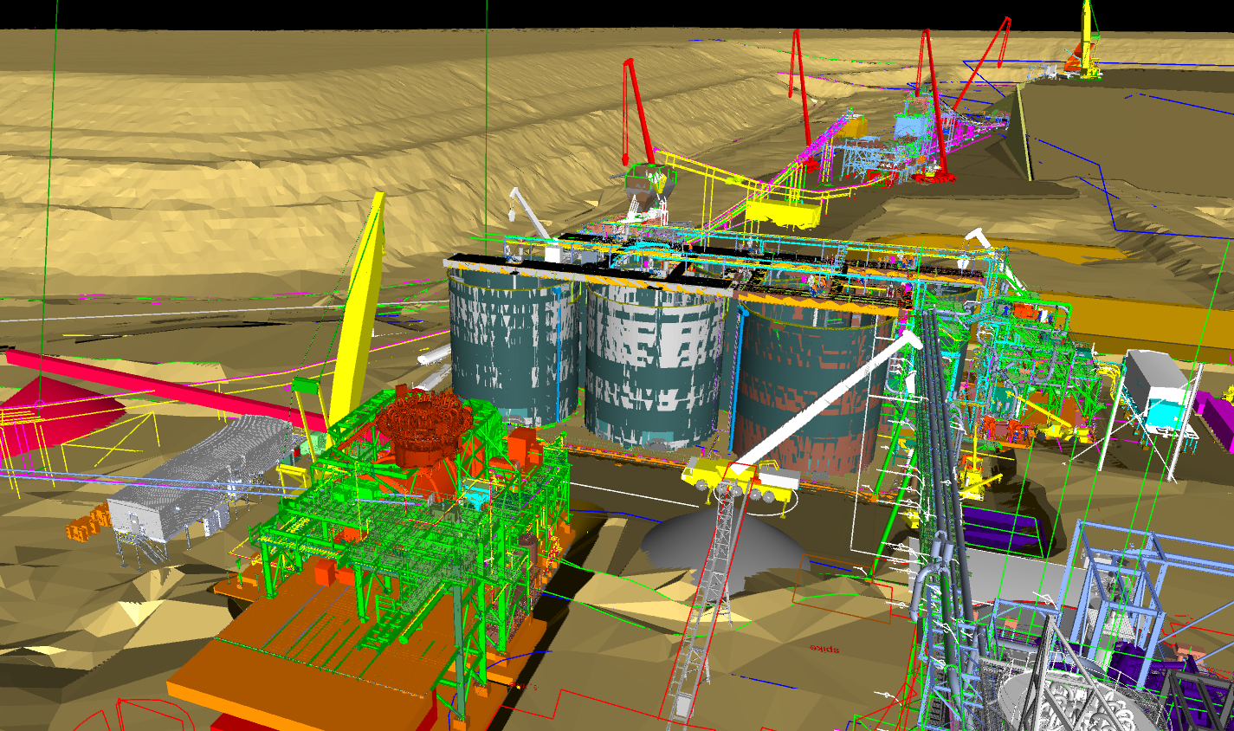
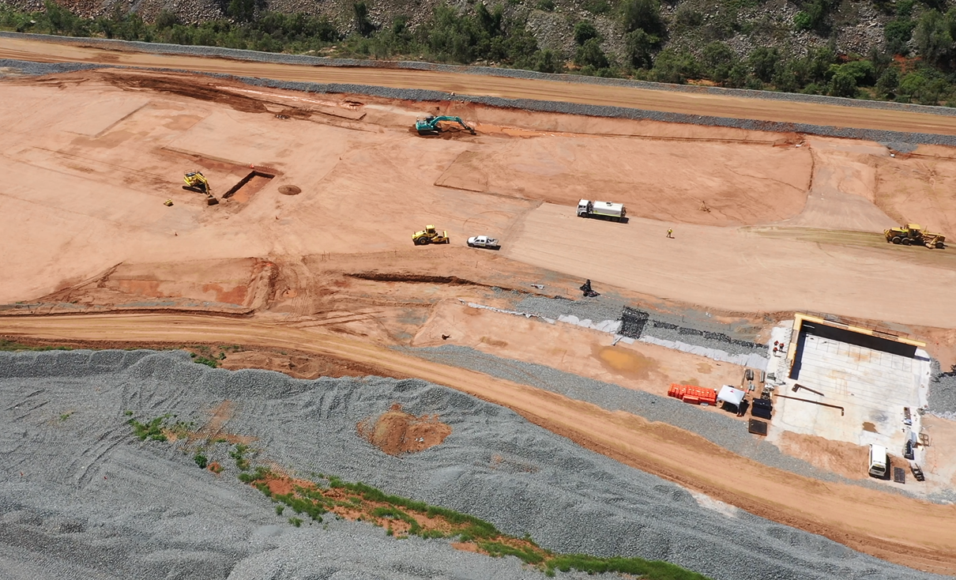
processing
  Stages 2 & 3
  New 3-stage crushing circuit
  Remaining leach tanks
    Retain >24 hrs residence time @ 7.2Mtpa
  4th Ball Mill

Slide 16
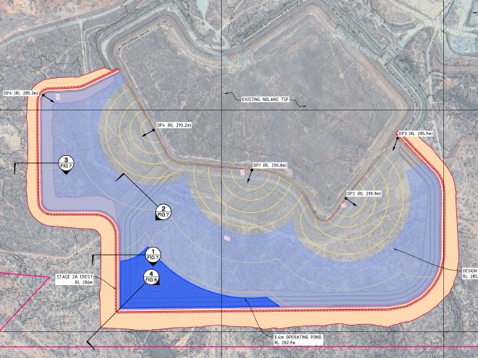
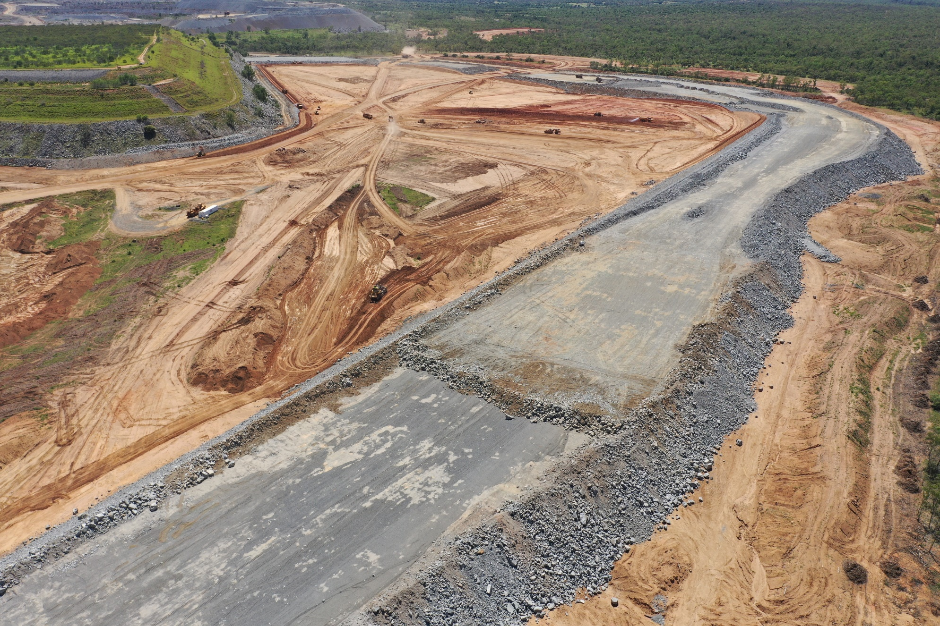
Tsf construction
  New TSF utilises the existing Nolans TSF for one of the embankments
  Fully lined (floor and walls) with a bituminous membrane
  All new embankments constructed with mine waste in downstream lifts
  Total footprint 160Ha
    Design capable of further lifts subject to regulatory approvals

Slide 17
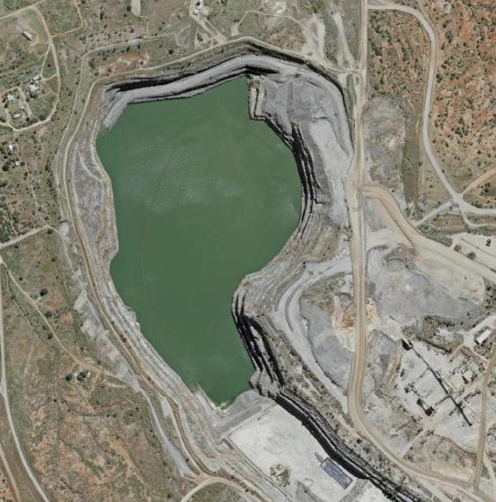
dredging
  Sarsfield pit void is the current TSF
  Will contain approximately 28Mt of tailings and 4GL of water by the time production tailings can go to the new TSF
    Initial dredging rates limited by rate of rise in the new TSF
  Water used to assist pumping the slurry to the new TSF
    Decant water from the new TSF returned to the pit void to keep the dredge afloat

Slide 18
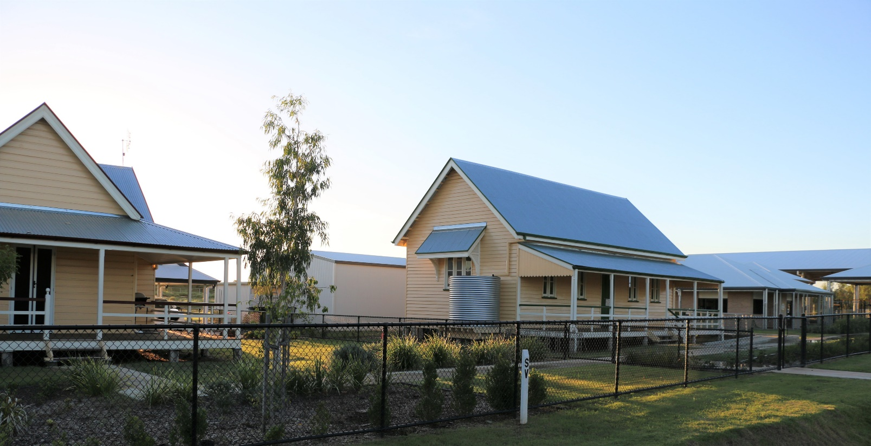
infrastructure
  Old Ravenswood State School was inside the new BRW pit shell
    New school built and heritage buildings relocated & renovated
  New Mine Services Area (mining offices, workshop, warehouse, fuel farm etc)
  Power lines, communications, water pipeline to be relocated
  New access road to the cemetery
  Intersection upgrades
  Camp expansion (250 → 498)
  New Water Treatment Plant required prior to Sarsfield mining

Slide 19
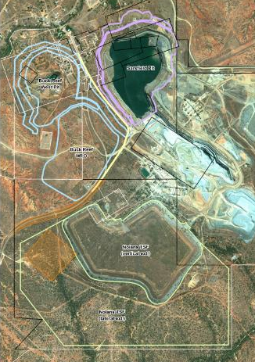
Approvals
Native Title Agreement (Birriah)
State of Queensland
    Heritage Agreement (Mining Landscape)
    Environmental Authority (EA) Amendments
    Mining Lease Applications
    New school (including Heritage Agreement)
    Department of Energy and Public Works
    Department of Transport and Main Roads
Charters Towers Regional Council
    Compensation Agreements
    Development Applications
    Road closures, opening and relocations
    Waste management facility relocation
  Australian Energy Regulator

Slide 20
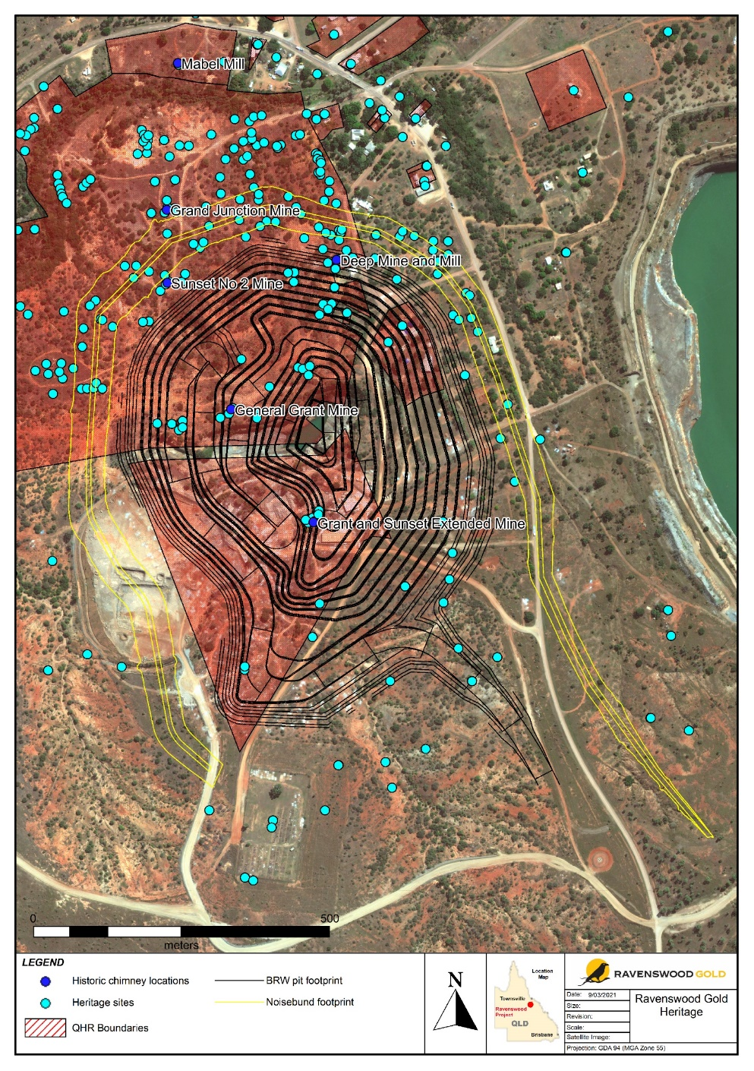
heritage
The Ravenswood Mining Landscape and Chinese Settlement Area was added to the Queensland Heritage Register in late 2016
Then owners (CG) entered into a Heritage Agreement with the State of Queensland to allow the project to continue
    Detailed archival recording of sites to be consumed by the project
    Restoration of sites to be retained
    All activities require an Exemption Certificate prior to any disturbance occurring
Separate Heritage Agreement and Exemption Certificates for relocation and renovation of the Ravenswood State School

Slide 21
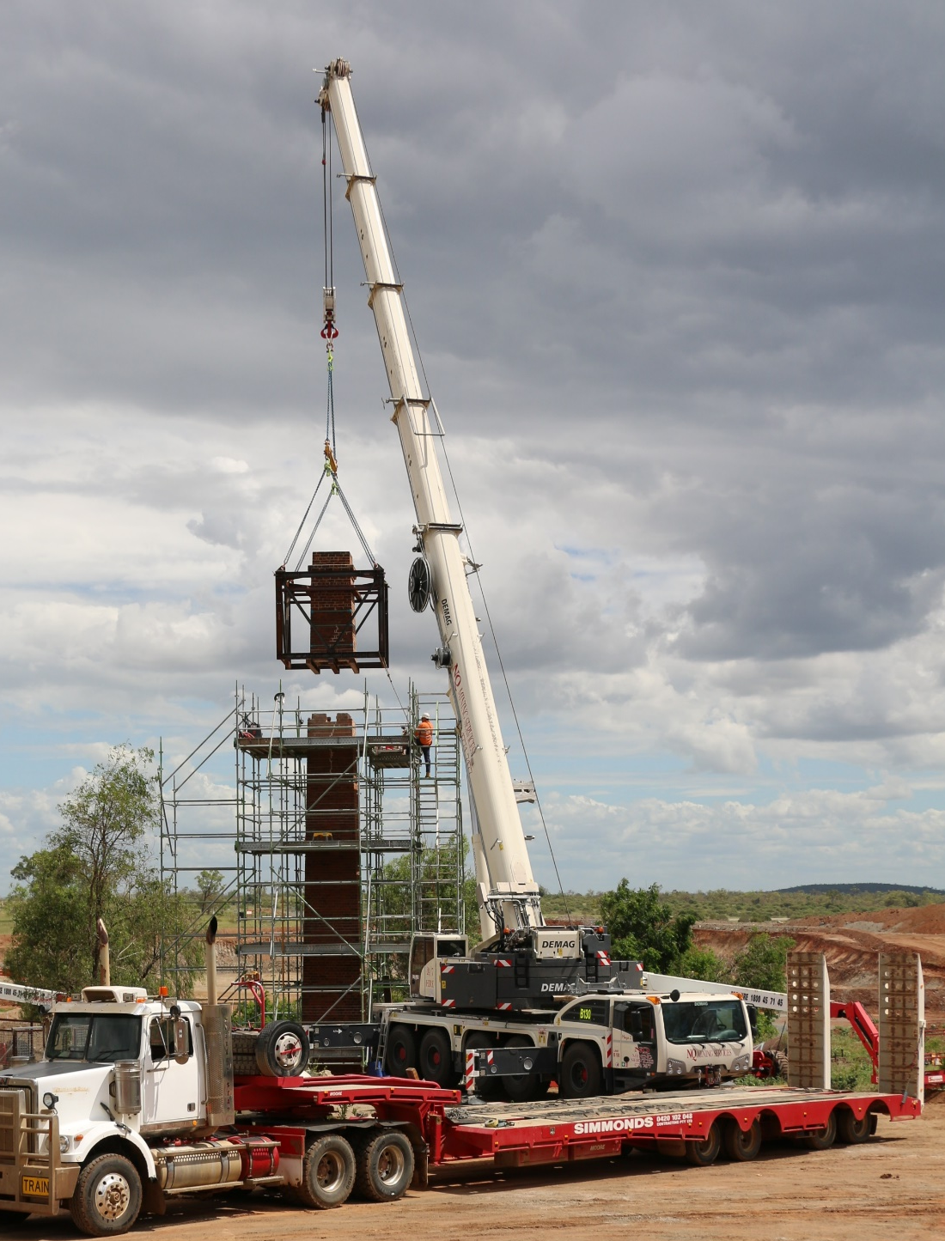
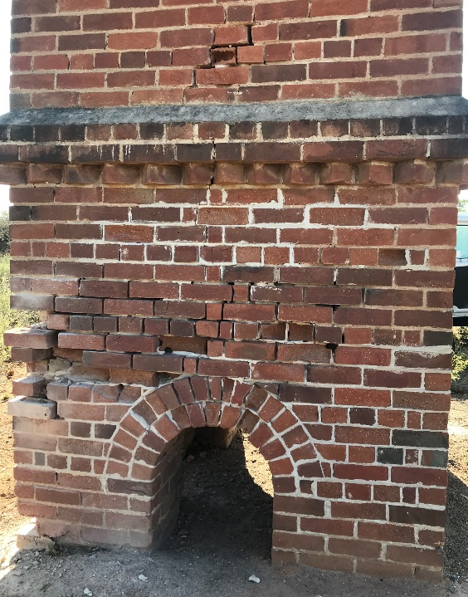
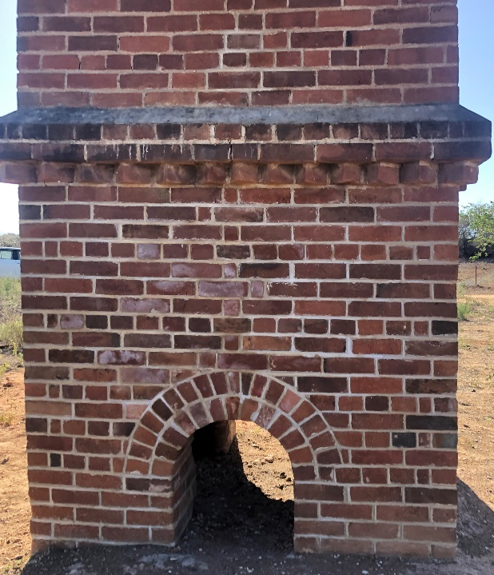
heritage
Three chimneys restored and strengthened by specialist contractors
    Sunset #2
    Grand Junction
    Mabel Mill
Three chimneys dismantled and relocated for future re-construction
    General Grant
    Grant and Sunset Extended
    Deep Mine

Slide 22
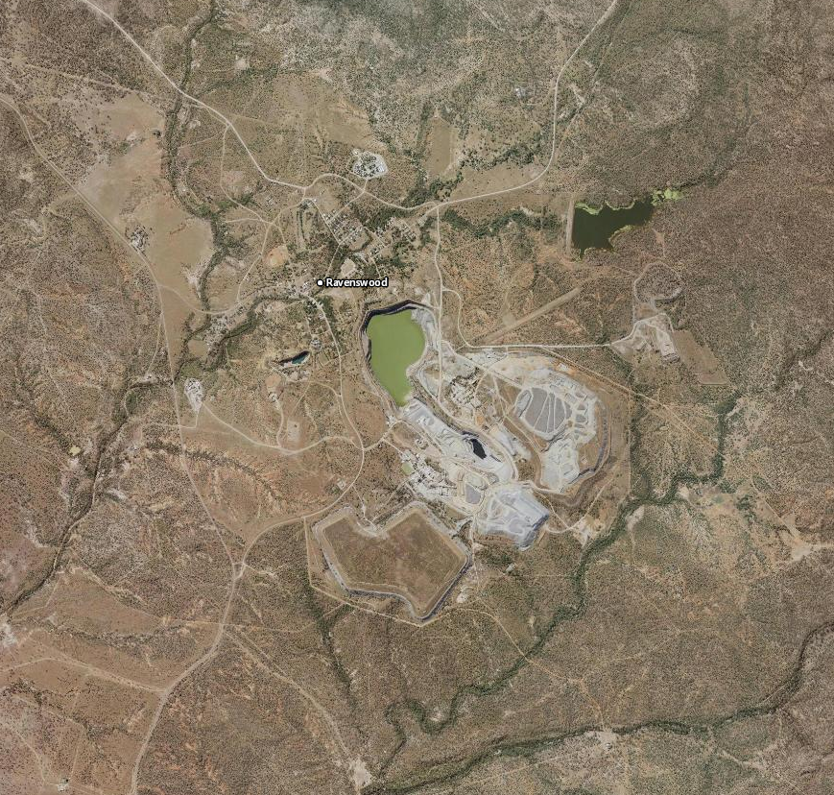
environment
Large volume of legacy issues
    Historic mining
    Grazing
    “Modern” mining (post 1980’s)
Mineralised nature of geology results in naturally elevated levels of some elements
Proximity of community to mining operations
Impossible to comply with an EA drafted using the “Model Mining Conditions”
Significant volume of work to obtain site-specific conditions, particularly relating to water quality (surface and ground water) and noise
Multiple EA Amendments along the journey as the project evolved

Slide 23
EA Amendments
Overview
Evolution of key EA Amendments
Environmental Authority EPML00979013
Most recent EA amendment approved March 2020 (see right for history of approvals)
Ravenswood has obtained all required environmental approvals for current operations
    BRW: Current EA permits the BRW expansion to proceed. Approvals include all outstanding permitting requirements (Native Title Agreement, Heritage Work Agreements, Underground Water Impact Report)
    SAR-NOL: All permits received for mining the SAR-NOL open pit and for the current tailings disposal into the pit
    TSF: The Current EA permits the TSF expansion to proceed, subject to specific EA requirements
A small number of minor approvals remain outstanding but are in progress and aligned with the Development Plan
In addition, Ravenswood has been granted Prescribed Project status by the Queensland Government due to its social and economic influence in the region and State
    This enables assistance from the Office of the Coordinator-General with approvals and processes related to the expansion
Approval​ | Purpose​ | Commentary​
Environmental Impact​ Statement (EIS) – Amendment​ | Sarsfield open pit expansion​ | Approved March 2017​
EA Amendment 1​ | Sarsfield open pit expansion​ | Issued March 2017​
EA Amendment 2​ | Buck Reef West open pit expansion​ | Issued March 2018​
EA Amendment 3​ | Nolans TSF expansion​ | Issued November 2019​
EA Amendment 4​ | Amended surface water conditions​ | Issued March 2020​

Slide 24
Thank you!
Any questions?

