Slide 1

Advance your career with AusIMM
Join our global community of over 16,000 resources professionals
ausimm.com/membership

Slide 2
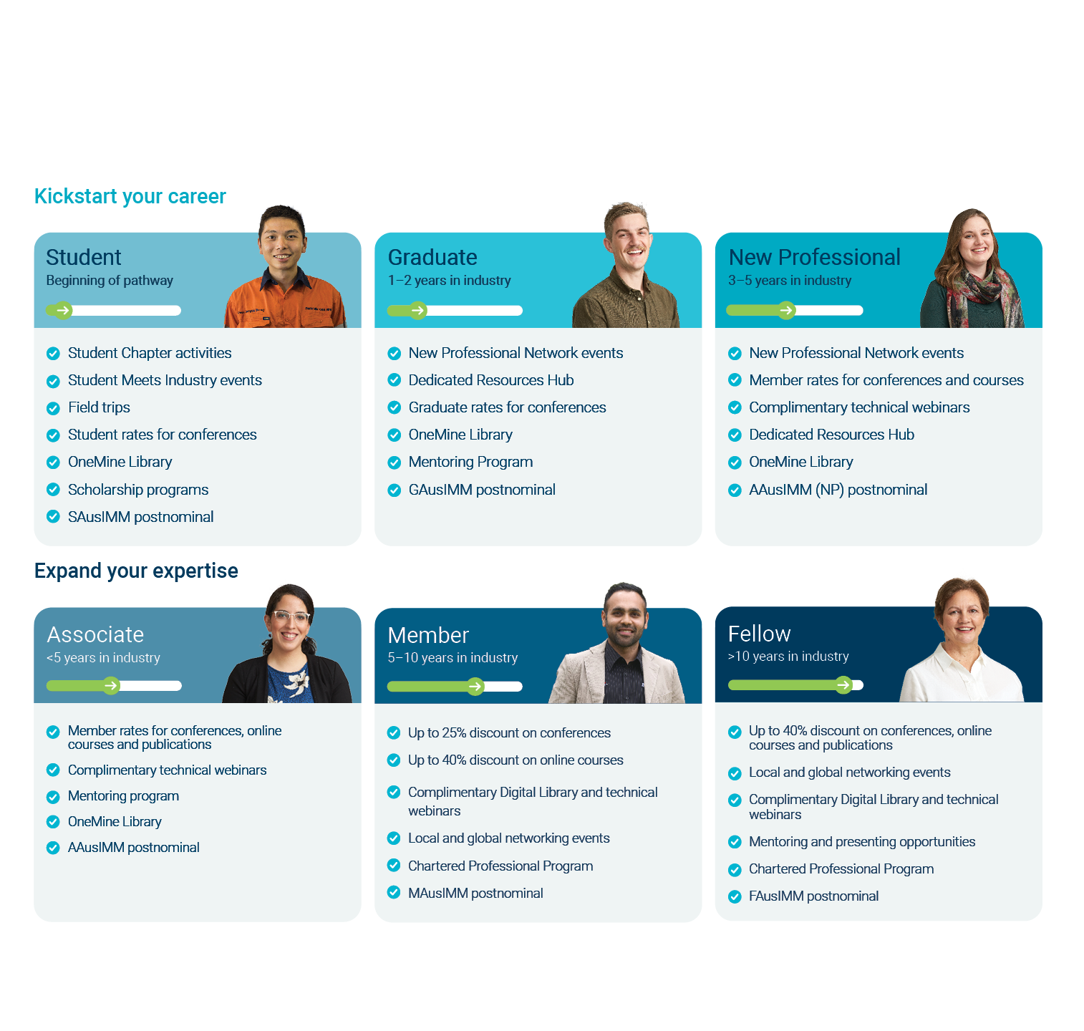

Membership
A member grade for every career stage
Scan for more information

Slide 3

Join our global community
Membership for every stage of your career
Be recognised with a global postnominal
Save on conferences, courses and more
Expand your network and build valuable industry connections
Get access to a vast library of 18,000+ items of technical content
Stay informed with regular industry news
Get involved in policy and advocacy initiatives to advance the sector
Get started at ausimm.com/membership

