Slide 1

Advance your career with AusIMM
Join our global community of over 16,000 resources professionals
ausimm.com/membership

Slide 2




Membership
Professional excellence in resources
AusIMM is the peak body for professionals in the resources sector. We advance careers, inspire leadership, uphold standards and connect communities.
Founded in
1893
Operates under
Royal Charter
More than
16,000 members
More than
20 local branches
Notes:
Founded in 1893
Operates under Royal Charter
More than 15,000 members around the world
More than 20 local branches

Slide 3
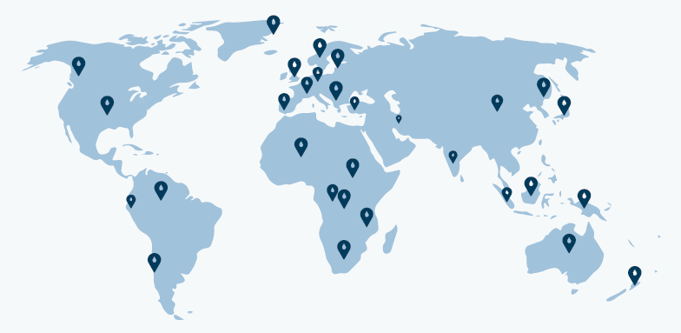
Advance your global career
As an AusIMM member, you become part of a thriving community encompassing all people in all professions, who are building a career in the resources sector.
Members are in more than 100 countries
Nearly 25% of members are outside of Australia and New Zealand

Slide 4
Membership
Support to achieve your career goals
Make the most of AusIMM membership and engage with innovative, contemporary and tailored opportunities developed to help advance your career in resources.
Advancing careers
Upholding standards
  Technical conferences
  Online courses
  Featured events
  Digital resources
  JORC and VALMIN Codes
  Chartered Professionals Program
  Policy Forums
Inspiring leadership
Connecting communities
  Thought Leadership Series
  New Leaders Summit
  Mentoring Program
  Communities of Interest
  Local Branches
  Student Chapters
  Networks

Slide 5
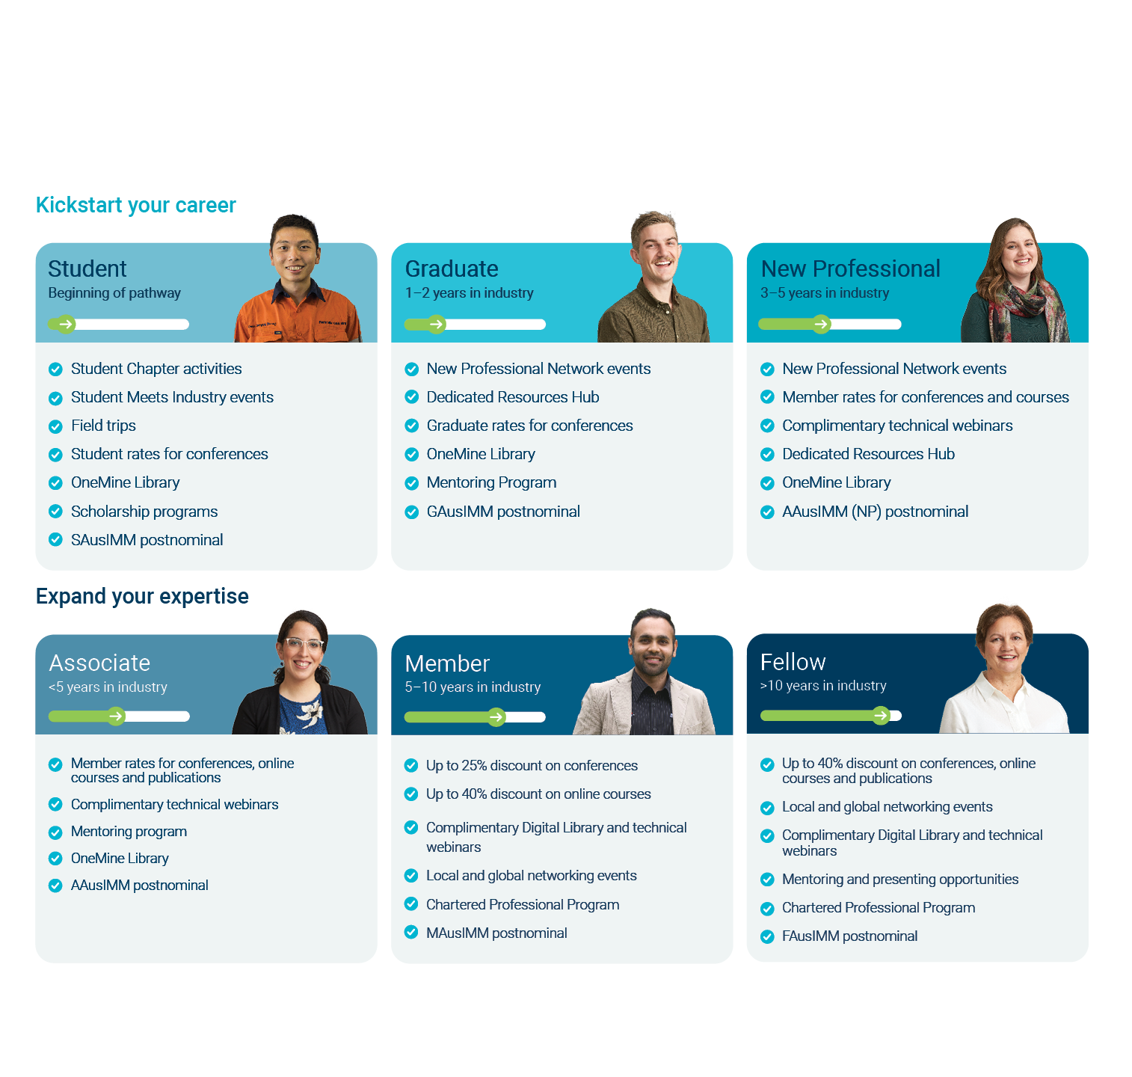

Membership
A member grade for every career stage
Scan for more information

Slide 6
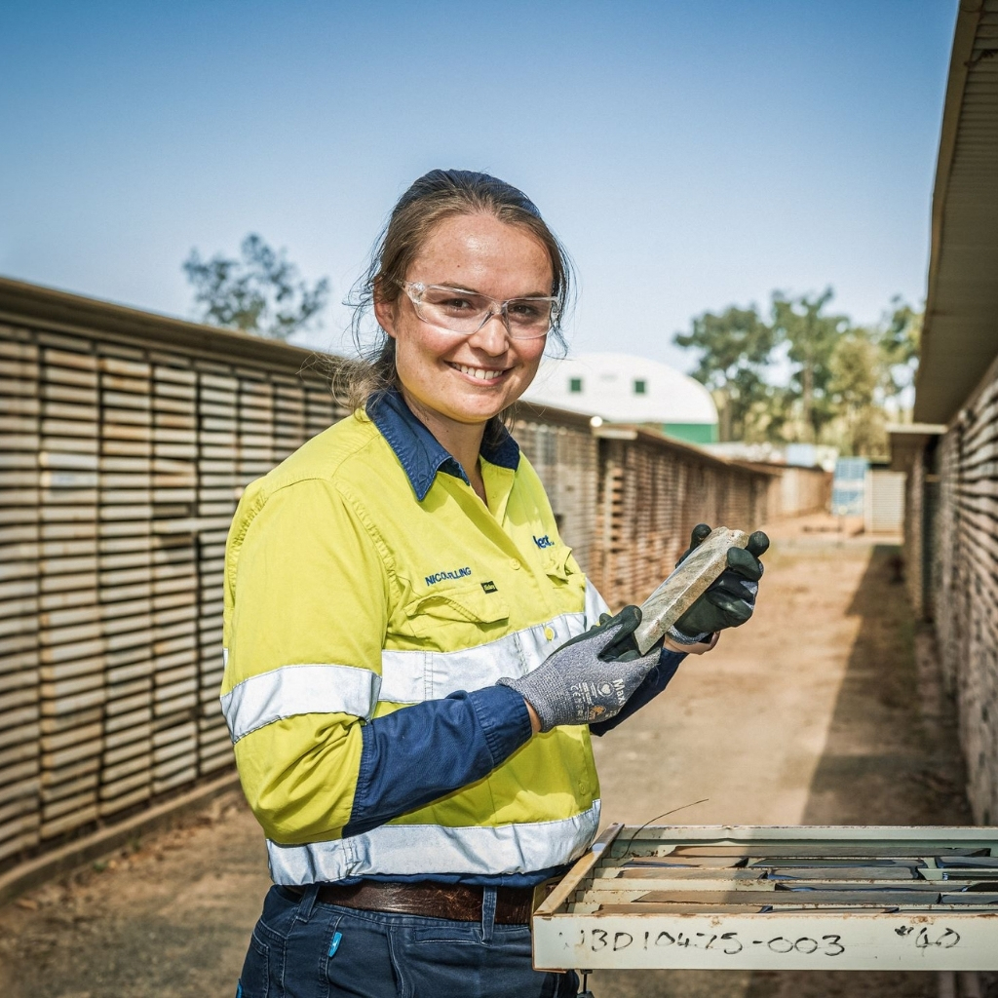
Kickstart your career
  Become a Student member (SAusIMM)
  Join your local Student Chapter
  Attend a Student Meets Industry event
  Apply for a scholarship
  Access the world’s biggest collection of mining and minerals research
  Free to join using code Student2026.
Get started

Slide 7
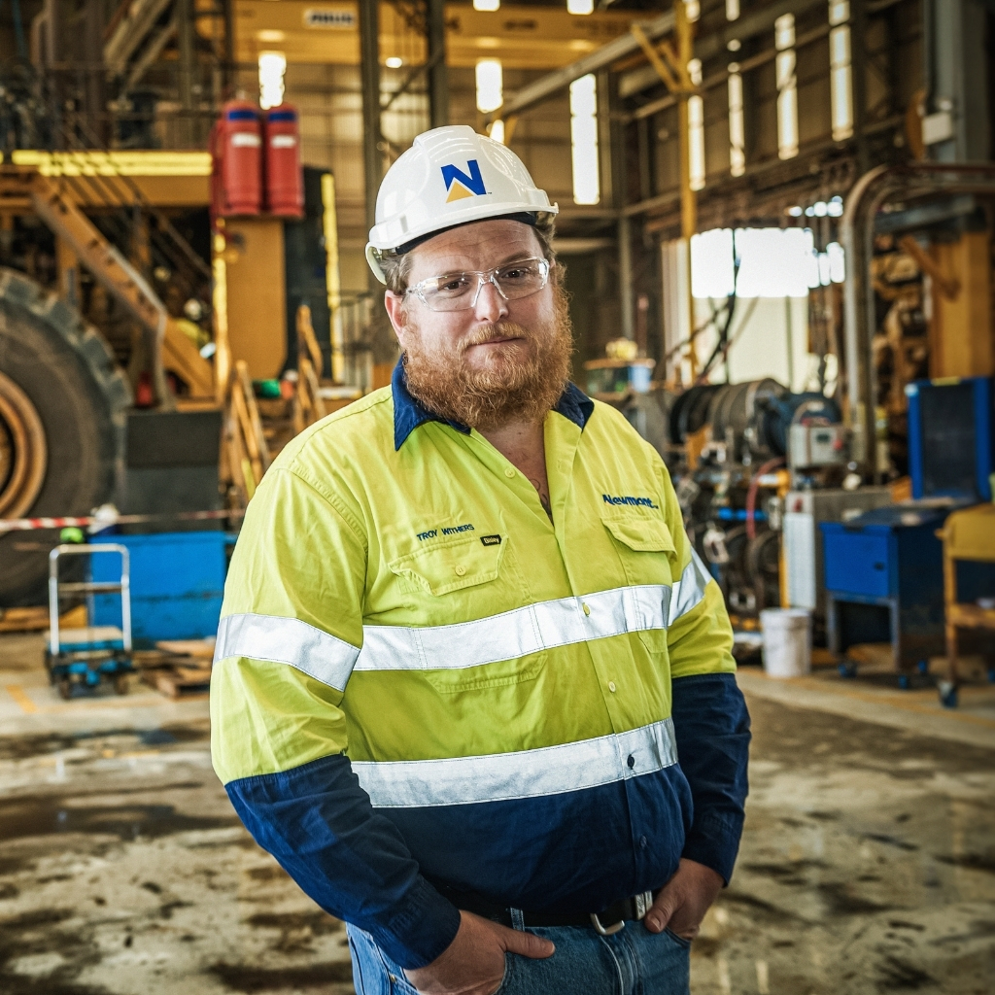
Accelerate your career
  Gain postnominals GAusIMM or AusIMM(NP)
  Access dedicated resources hub
  Join the New Professionals Network
  Attend an AusIMM technical conference
  Participate in an online course
  Connect with like-minded professionals at community events

Slide 8
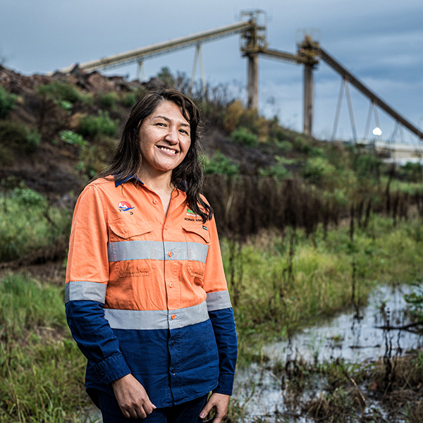
Expand your experience
Showcase your experience with MAusIMM postnominal
Meet the requirements to be a Competent Person or Chartered Professional
Present a conference abstract
Enrol in an online course
Attend an AusIMM technical conference
Get involved in policy and advocacy
Lead an AusIMM community group
Become a mentor and shape the next generation

Slide 9
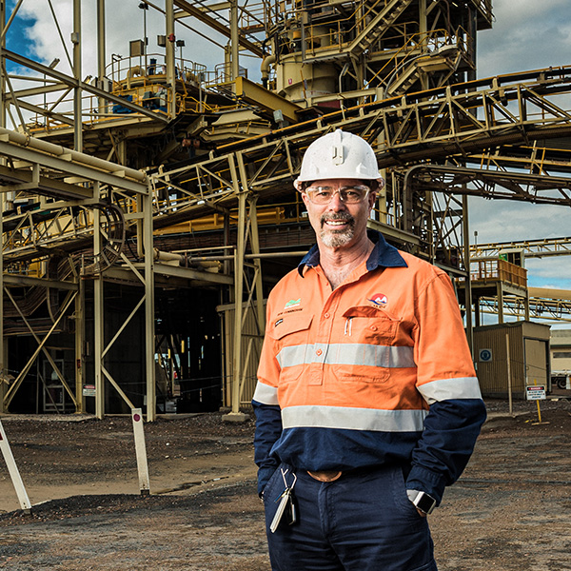
Leave a legacy
Showcase your significant industry contributions with FAusIMM postnominal
Meet the requirements to be a Competent Person or Chartered Professional
Share your deep industry knowledge and experience
Mentor a new professional
Present at a technical conference
Lead a specialty community of interest
Engage in policy and advocacy outcomes
Get started

Slide 10
Get involved with one of our communities
Branches
Student Chapters
Networks
AusIMM Branches provide a wide range of events and activities for members and other mining professionals in regional and metropolitan areas.
AusIMM Student Chapters offer future leaders the opportunity to engage and learn at our wide range of networking events and professional development sessions.
AusIMM Networks provide opportunities to connect, contribute and learn from other industry professionals in the mining industry beyond the core disciplines.
Societies
International
Committees
AusIMM Societies are comprised of members with expertise in a particular discipline or area of practice.
AusIMM International connects all mining industry professionals as part of our strong and expanding global community.
AusIMM Committees include a diverse range of individuals representing the sector, focusing on special areas of interests.

Slide 11
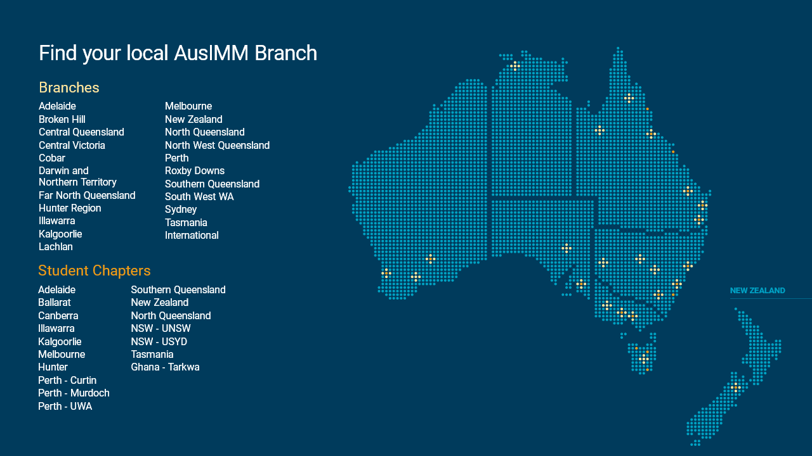

Slide 12




Membership
It’s easy to become an AusIMM member
Here’s how to get started
Take the 60-second quiz to get matched with the best membership.
Complete your membership application online.
Set up your preferences to start receiving value.
Get started at ausimm.com/membership

Slide 13
Join our global community today.
Your local contact for more information about AusIMM membership is:
Local Contact details go here.

Slide 14
Join our global community
Membership for every stage of your career
Be recognised with a global postnominal
Save on conferences, courses and more
Expand your network and build valuable industry connections
Get access to a vast library of 18,000+ items of technical content
Stay informed with regular industry news
Get involved in policy and advocacy initiatives to advance the sector
Get started at ausimm.com/membership

