Slide 1

Membership
"Whether you're FIFO or city based, AusIMM is a fantastic community where you can mingle and meet peers and industry leaders."
Josephine Liantono
AAusIMM
Mine Infrastructure Engineer, BHP

Slide 2
Membership
"AusIMM has developed my professional skills, public speaking, and exposure to the rest of the industry."
Thomas Taylor
MAusIMM
Senior Metallurgist at Fortescue Iron Bridge

Slide 3
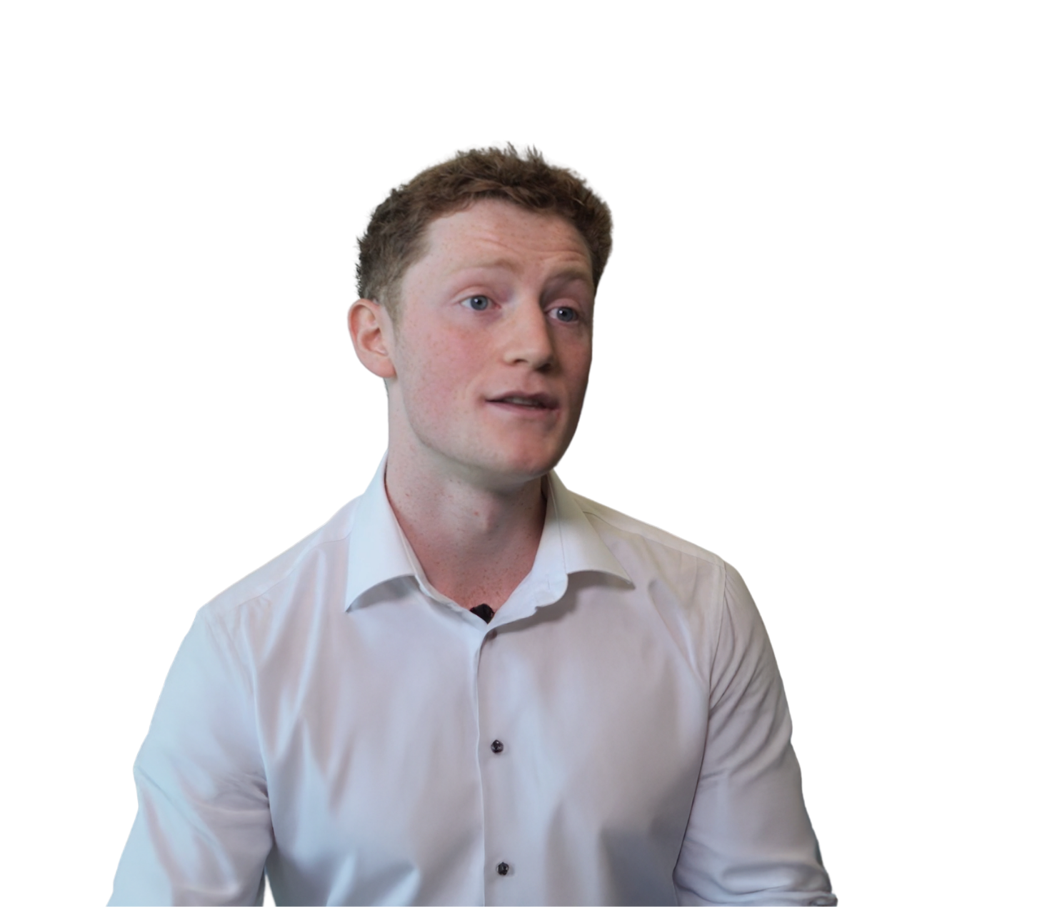
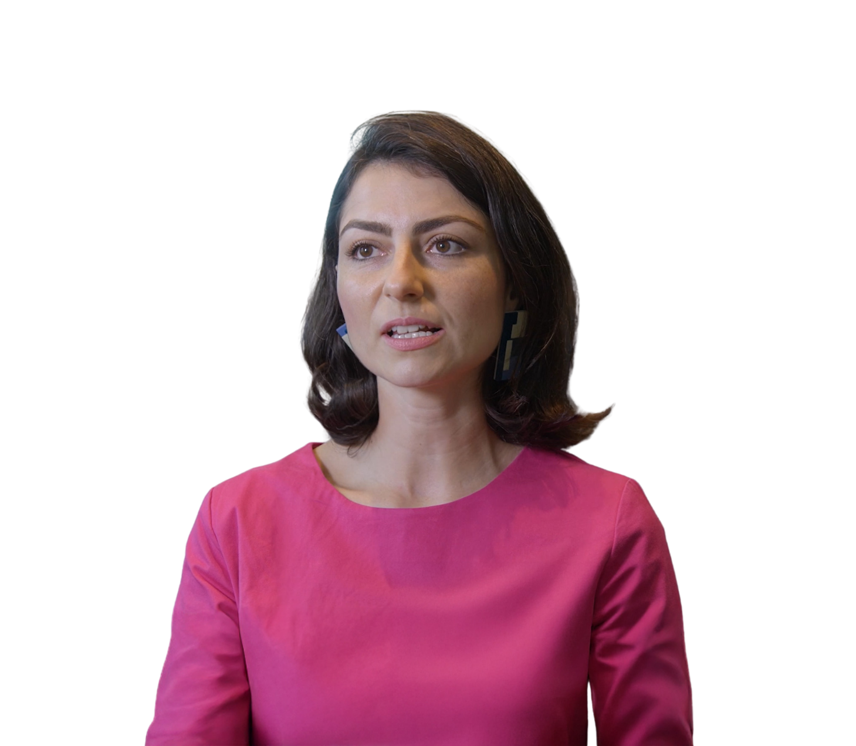
Membership
“AusIMM has elevated my career through exposure to different facets of the mining industry. ”
Oliver Mowbray
AAusIMM
Geophysicist, Southern Geoscience Consultant
“AusIMM has elevated my career through exposure to different facets of the mining industry.”
Ana Chiquini
MAusIMM (CP)
Principal Geologist at Resource Modeling Solutions

