Slide 1
Membership
“Whether you're FIFO or city based, AusIMM is a fantastic community where you can mingle and meet peers and industry leaders.”
Josephine Liantono
AAusIMM
Mine Infrastructure Engineer, BHP

Slide 2
Membership
“AusIMM has developed my professional skills, public speaking, and exposure to the rest of the industry.”
Thomas Taylor
MAusIMM
Senior Metallurgist at Fortescue Iron Bridge

Slide 3
Membership
‘‘Being able to network with people, being able to understand what's happening in the mining industry and being able to give back.”
Alex Bozward
FAusIMM(CP)
New Market & Innovation Manager, GMA Garnet Group

Slide 4
Membership
“AusIMM has elevated my career through exposure to different facets of the mining industry.”
Ana Chiquini
MAusIMM(CP)
Principal Geologist at Resource Modeling Solutions

Slide 5
Membership
"I recommend AusIMM membership to any
young professional
student that's involved
in resources. It has built
my career up in a very fundamental way."
Oliver Mowbray
AAusIMM
Geophysicist, Southern Geoscience Consultant

Slide 6
Membership
“AusIMM has supported
me with professional development, especially knowledge at conferences.”
Prof. Ismet Canbulat
FAusIMM
Professor & Head of School, UNSW Sydney

Slide 7
Membership
"The best thing about AusIMM is connecting with other like-minded people in the industry and learning about the latest industry trends."
Linda Pang
SAusIMM
Perth – UWA Student Chapter

Slide 8
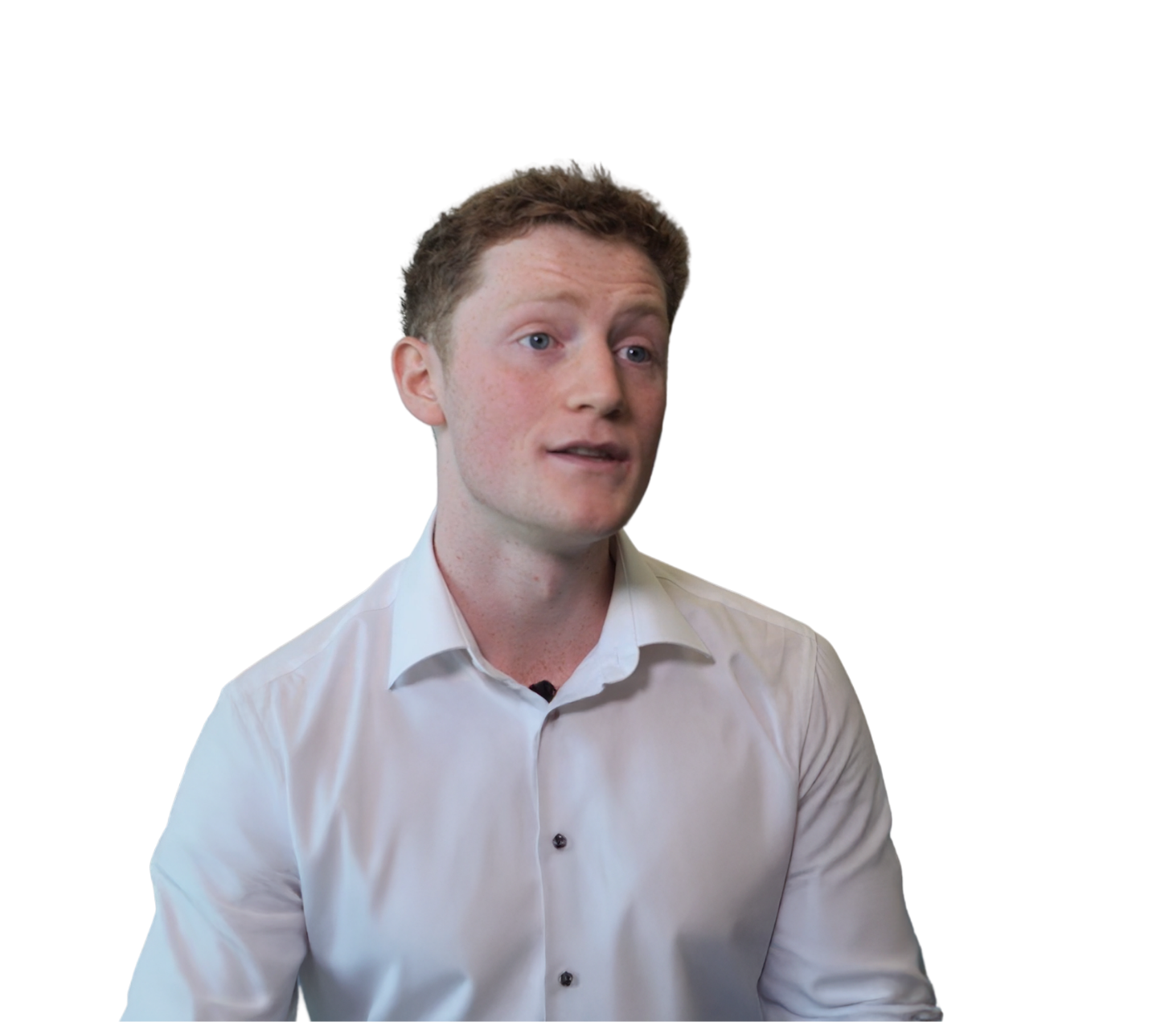
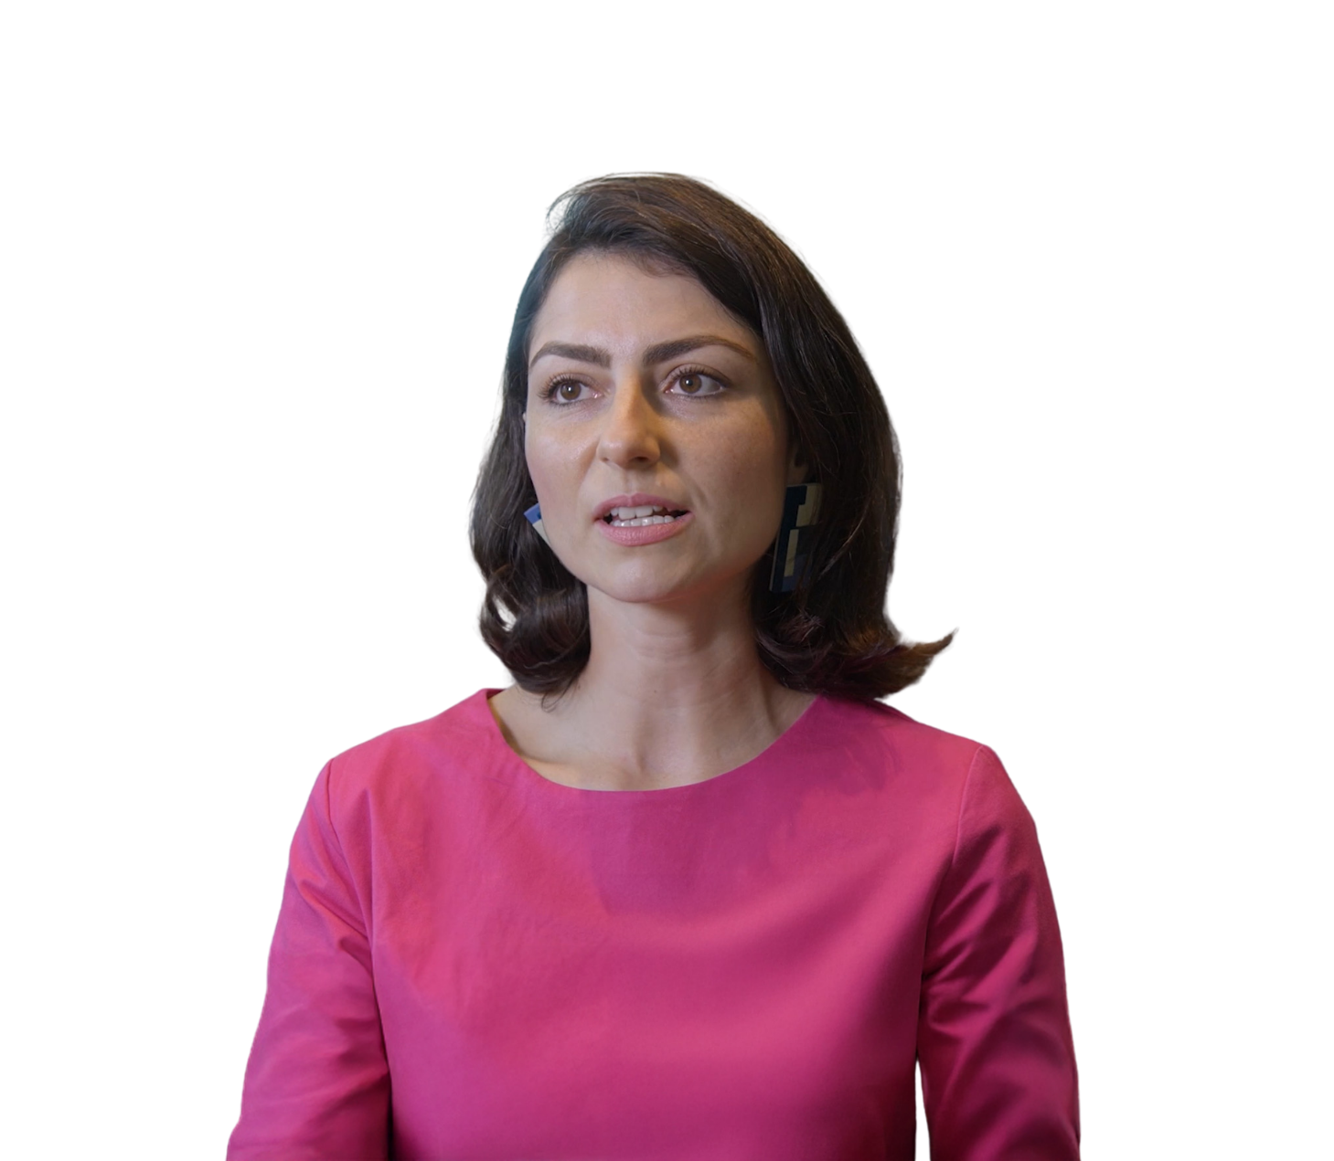
Membership
“I recommend AusIMM membership to any young professional students that's involved in resources. It has built my career up in a very fundamental way.”
Oliver Mowbray
AAusIMM
Geophysicist, Southern
Geoscience Consultants
“AusIMM has elevated my career through exposure to different facets of the mining industry.”
Ana Chiquini
MAusIMM (CP)
Principal Geologist,
Resource Modelling Solutions

Slide 9
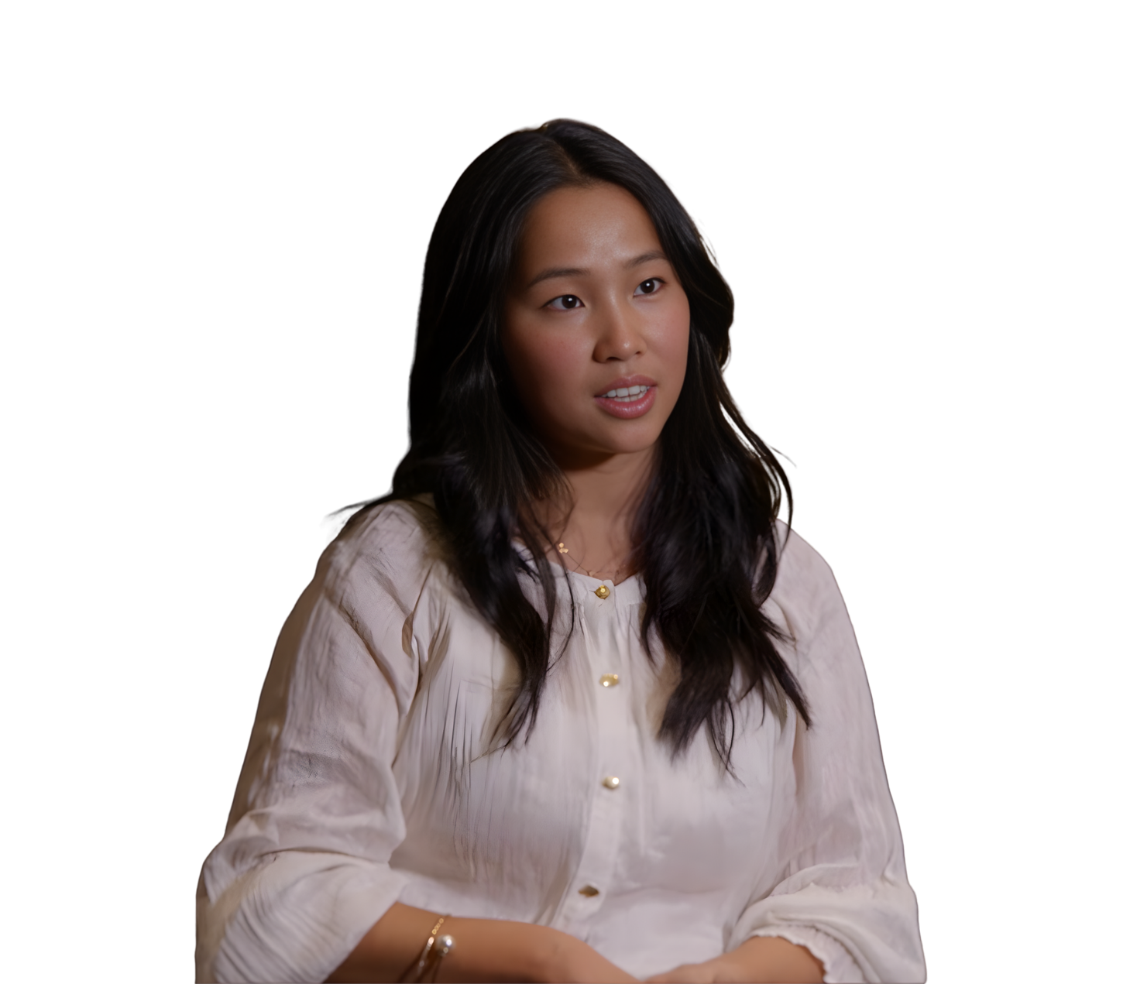
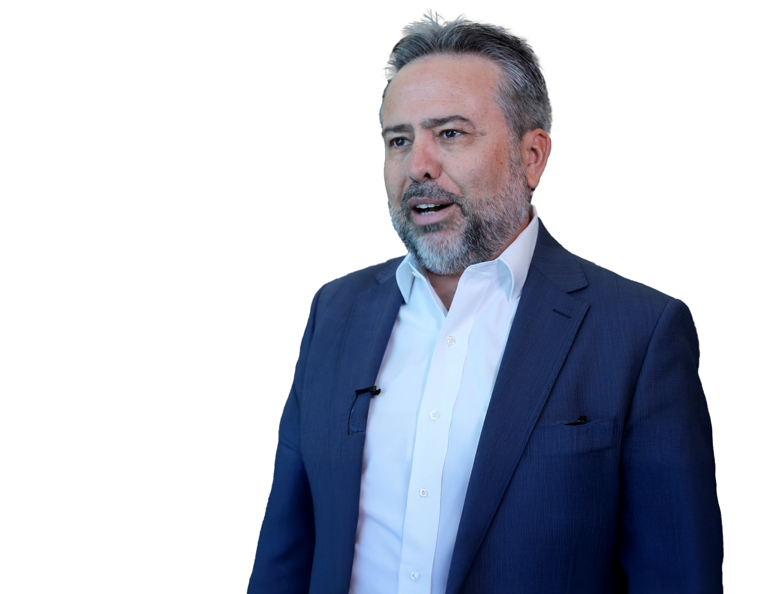
Membership
“AusIMM has supported me with professional development, especially knowledge at conferences.”
Prof. Ismet Canbulat
FAusIMM
Professor & Head of School,
UNSW Sydney
“The best thing about AusIMM is connecting with other like-minded people in the industry and learning about the latest industry trends.”
Linda Pang
SAusIMM
Perth – UWA
Student Chapter

Slide 10
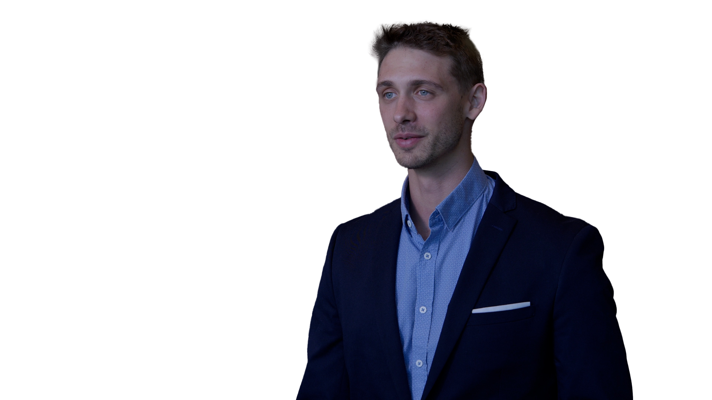
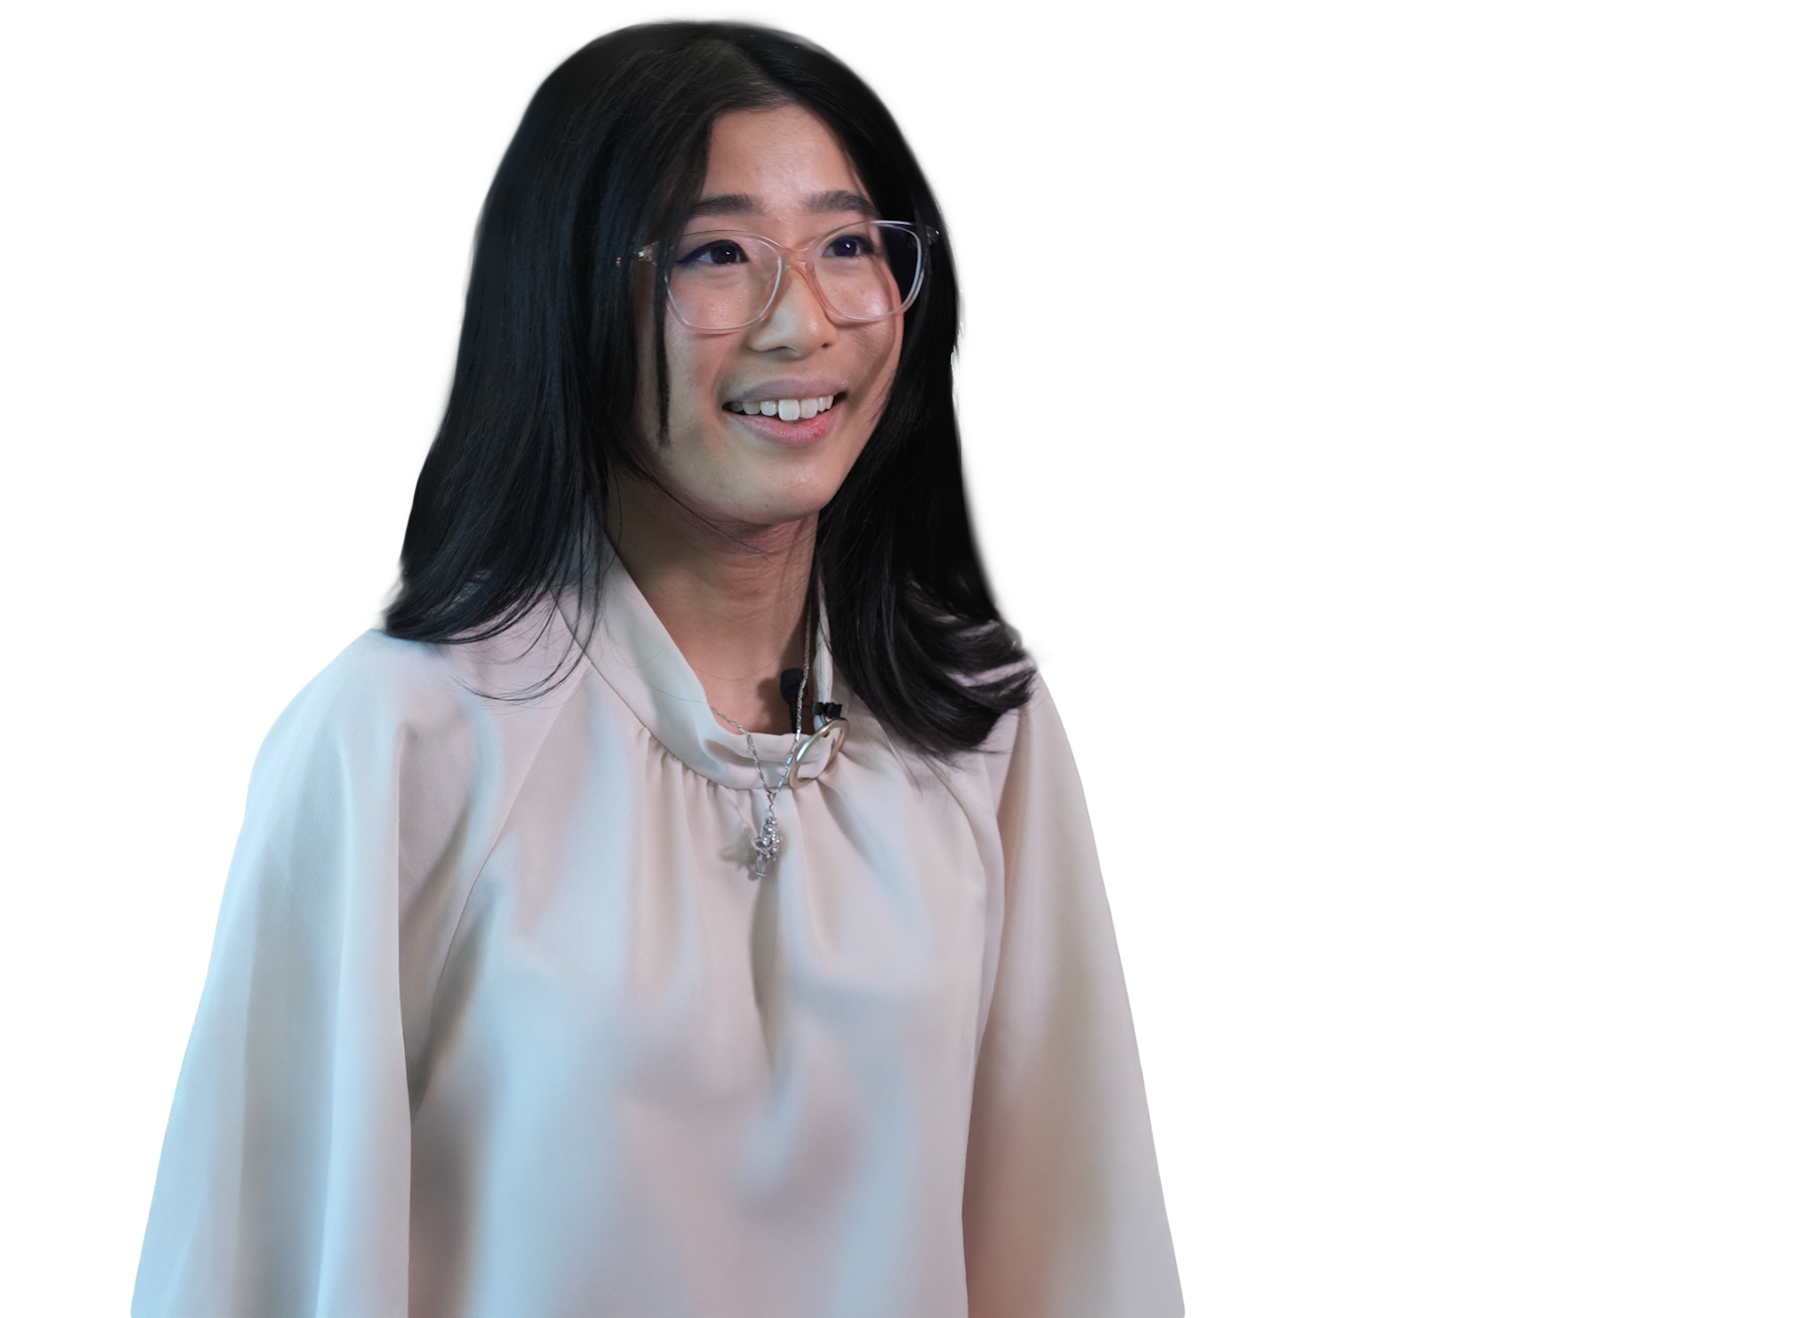
Membership
“AusIMM has developed my professional skills, public speaking, and exposure to the rest of the industry.”
Thomas Taylor
MAusIMM
Senior Metallurgist,
Fortescue Iron Bridge
“Whether you're FIFO or city based, AusIMM is a fantastic community where you can mingle and meet peers and industry leaders.”
Josephine Liantono
AAusIMM
Mine Infrastructure
Engineer, BHP

