Slide 1

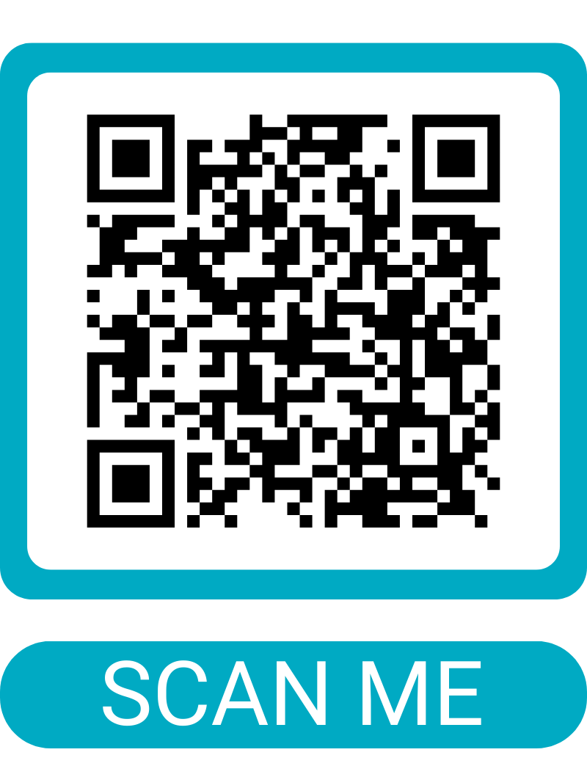
Become an AusIMM Member in 2026
Kickstart your career in resources
Student
Graduate
Beginning of pathway
1-2 years in industry
17 global Student Chapters
Develop industry contacts
Students Meets Industry events
Enjoy free resources, technical webinars
Access student scholarships
Showcase your postnominals (SAusIMM)
Access to Prosple job platform
New Professionals Network events
Dedicated Resources Hub
Graduate rates for conferences
Complimentary technical webinars
OneMine Library
Mentoring Program
GAusIMM postnominal
Exclusive industry news
Access dedicated Mentoring Program
Get started at ausimm.com/membership
Free to join using code Student2026

Slide 2
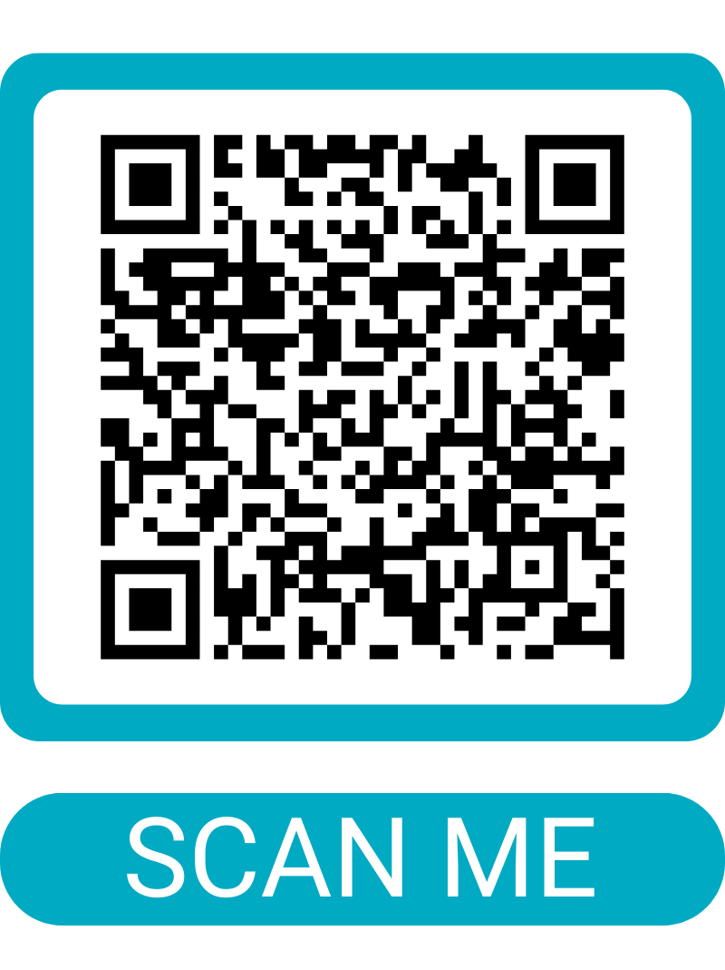
Become an AusIMM Student member in 2026
Kickstart your career in resources
Student
Beginning of pathway
17 global Student Chapters
Develop industry contacts
Students Meets Industry events
Enjoy free resources, technical webinars
Access student scholarships
Showcase your postnominals (SAusIMM)
Access to Prosple job platform
Free to join using code Student2026
Get started at ausimm.com/membership

